Slide 1

SHAHZAD TEXTILE
MILLS LIMITED
Corporate Briefing
For the year ended June 30, 2025
Corporate Briefing Session 2025 – November 14, 2025

Slide 2
OUTLINES
Company Brief
Strategic & Operational Development
Financial Details
Question & Answer
Corporate Briefing Session 2025 – November 14, 2025

Slide 3
COMPANY BRIEF
Corporate Briefing Session 2025 – November 14, 2025

Slide 4
COMPANY BRIEF
ORGANIZATION HISTORY
  Shahzad Textile Mills Limited (the Company) was incorporated in Pakistan on October 24, 1978 as a Public Limited Company under the Companies Act, 1913 (now the Companies Act, 2017). The shares of the Company are quoted on Pakistan Stock Exchange. The Company is domiciled in Pakistan and principle business of the Company is to manufacture and deal in all types of yarn and Socks.
  Spinning Segment
  Socks Segment
Corporate Briefing Session 2025 – November 14, 2025

Slide 5
SPINNING SEGMENT
Current Spindles | Plant Capacity & Production
June- 2025 | Plant Capacity (20/S) | Actual Production Converted into 20/S Count
70,428 | 41,732,689 (Kgs.) | 780,919 (Bags) | 35,422,486 (Kgs.)
The Company has been operating in Spinning segment for more than 47 years since 1978. And producing all types of Textile yarn.
Spinning Unit 1, 4 and Socks Unit are situated at 34th Km, Lahore Sheikhupura Road, Sheikhupura.
Spinning Unit 2 is situated at 7th Km, Sheikhupura Faisalabad Road, Sheikhupura
Corporate Briefing Session 2025 – November 14, 2025

Slide 6
SOCKS SEGMENT
No. of Machines | Installed Capacity Dozen Socks (p.a.) | Utilized Capacity Dozen Socks (p.a.)
187 | 2,398,387 | 1,785,401
The Management is continuously evaluating the potential of expansion in Socks Segment by negotiating with existing banks and own sources.
Foreign Business tours are made to explore potential markets and strengthen relationship with existing customers’ to enhance export sales and profitability.
Toll Manufacturing Services are provided to absorb fixed cost and utilized spare capacity.
Current FY:2025 company has earned Toll Manufacturing income of Rs. 73.89M (2024: 70.418 M)
Corporate Briefing Session 2025 – November 14, 2025

Slide 7
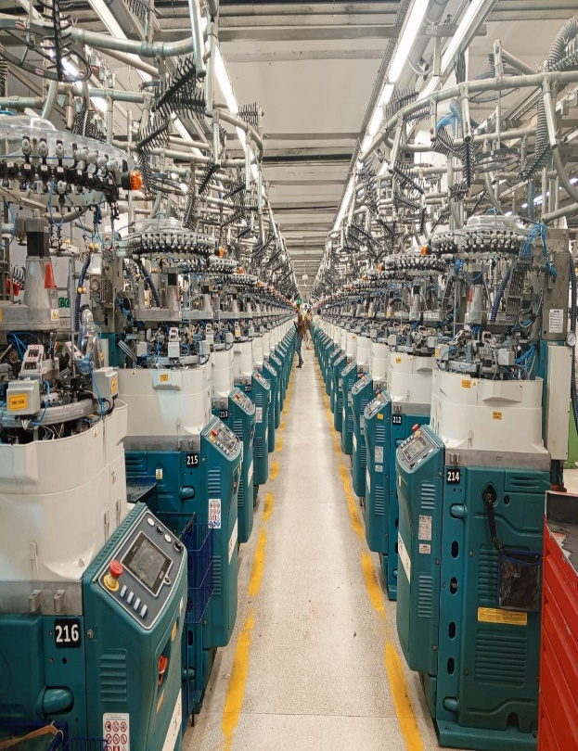
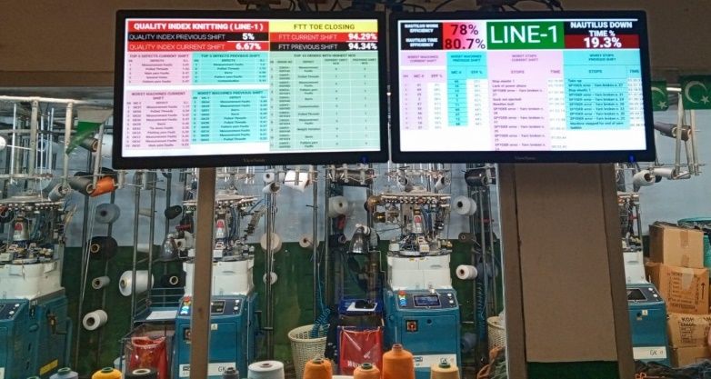
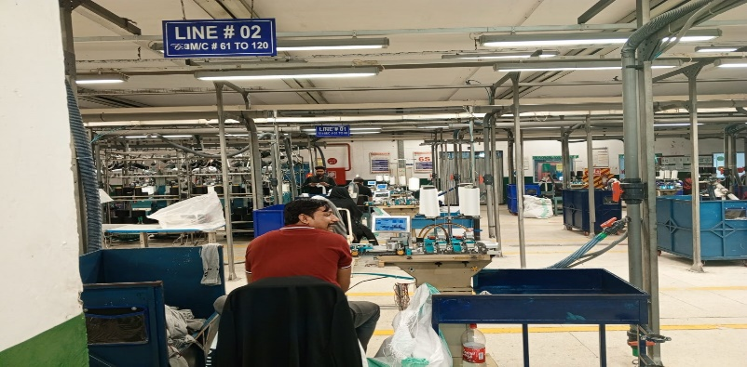
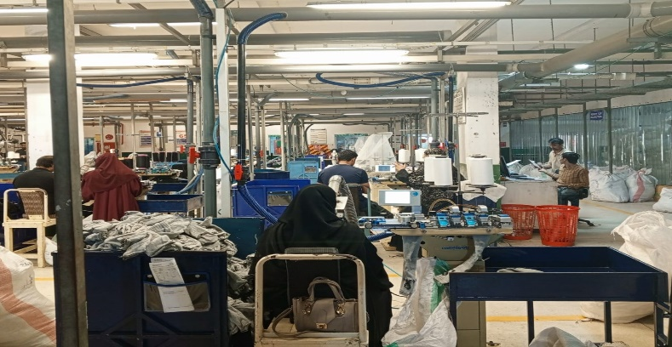
MACHINERY VISUALS
Plant facility comprise of state of the art machines i.e. Lonati Knitting Machines of 120 & 144 Needles, Sock Linking Rosso

Slide 8
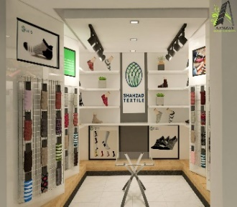



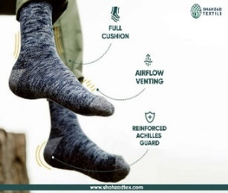
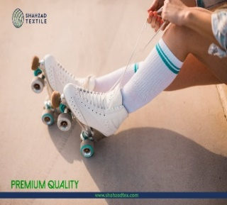
SOCKS PRODUCTS
We can make all sorts of socks, from most basic to the most
technical. Our products are geared towards quality-conscious
customers. Plant facility has capable OF PRODUCING various types
of socks i.e.
  Work-wear Socks
  Athletic Socks
  Diabetic Socks
  Thermal Socks
  Formal Dress Socks
  Treated socks
  All other kind of socks
Corporate Briefing Session 2025 – November 14, 2025

Slide 9
RATING FROM PACRA
Rating Category | Long Term Rating | Short Term Rating
Rating | A- | A2
Above rating is as per latest press release on April 2025 by PACRA
This rating is maintained for last four releases by PACRA shows stable corporate economic and financial condition
Corporate Briefing Session 2025 – November 14, 2025

Slide 10
Corporate Role in Socio Economic Development
Numbers of Workers & Employees | Permanent |  | Total
 | H.O | Mills
Employees as at year end | 30 | 1668 | 1,698
Avg. employees during the year | 30 | 1674 | 1,704
Corporate Briefing Session 2025 – November 14, 2025

Slide 11
STRATEGIC & OPERATIONAL DEVELOPMENT
Corporate Briefing Session 2025 – November 14, 2025

Slide 12
FINANCING FACILITIES
(LTFF)
LONG TERM FINANCING FACILITY – LTFF
    For Socks Unit
      Sanctioned Facility for Socks Machinery Rs. 291 million
      Out Standing Facility till June-2025 Rs. 191.696 million
      Above LTFF facility is for 7 years with 1 year grace period, its repayment is started from April 2021 and ended in January 2029.
    For Spinning Unit
      Sanctioned Facility for spinning machinery Rs. 100.0 million under Diminishing Musharaka.
      Out Standing Facility till June-2025 Rs. 29.741million
      This facility is repayable in 5 years with 1 year grace period, repayment is started from August 2023 and ended in July 2027.
Corporate Briefing Session 2025 – November 14, 2025

Slide 13
Short Term Financing Facilities
    The Company has obtained various funded and unfunded financial facilities from different banks for a total sanctioned limit of Rs. 2,216 million towards working capital requirements, retirement of local and foreign LCs and discounting of local bills / receivables.
    The company has utilized Rs. 550.519 million against funded facility as at June 30, 2025.
    The company has also utilized Rs. 387.064 million of un-funded facility as at June 30, 2025.
    An Interest-free sponsor loan of Rs. 321M from Directors to support the working capital requirements of the Company.
Corporate Briefing Session 2025 – November 14, 2025

Slide 14
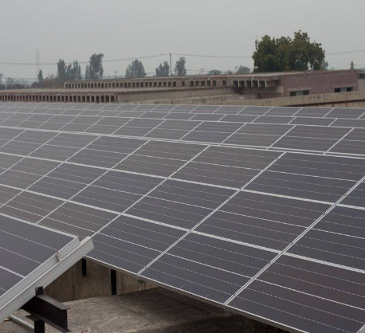
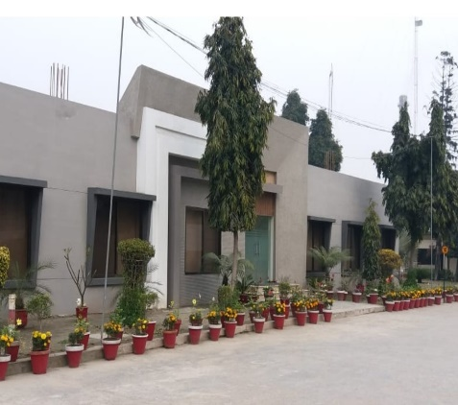
STRATEGIC & OPERATIONAL DEVELOPMENT
SOLAR Energy System
SOCKS Unit
Corporate Briefing Session 2025 – November 14, 2025

Slide 15
SOLAR ENERGY SYSTEM
The Board of Directors has proposed to dispose of the Company's Asset classified as “Asset held for Sale” situated at Tricon Corporate Center, 73-E, Main Jail Road, Gulberg-II, Lahore, to generate funds for the utilization towards capital investment for installation of a new Solar Energy System at the Company's mills site.
This investment is crucial for long term sustainability and profitability of the Company. This will help the Company to cope with the high energy costs, reducing the cost of production to remain competitive in the market.
Corporate Briefing Session 2025 – November 14, 2025

Slide 16
SOCKS UNIT
Presently Company installed 187 socks knitting machines along with related machinery. However, building and other allied machinery is sufficient to support 350 knitting machines. Management is intended to achieve economies of scale and reduce per unit fixed cost
Existing Project Size is PKR 1,740.86 million approximately.
Corporate Briefing Session 2025 – November 14, 2025

Slide 17
FINANCIAL DETAILS
Corporate Briefing Session 2025 – November 14, 2025

Slide 18
Corporate Briefing Session 2025 – November 14, 2025

Slide 19
Corporate Briefing Session 2025 – November 14, 2025

Slide 20
Corporate Briefing Session 2025 – November 14, 2025

Slide 21
Corporate Briefing Session 2025 – November 14, 2025

Slide 22
6 YEAR’S SALES & GROSS PROFIT ANALYSIS
Corporate Briefing Session 2025 – November 14, 2025

Slide 23
Question & ANSWER
SESSION
Corporate Briefing Session 2025 – November 14, 2025

Slide 24

THANKING YOU
Corporate Briefing Session 2025 – November 14, 2025

